Slide 1
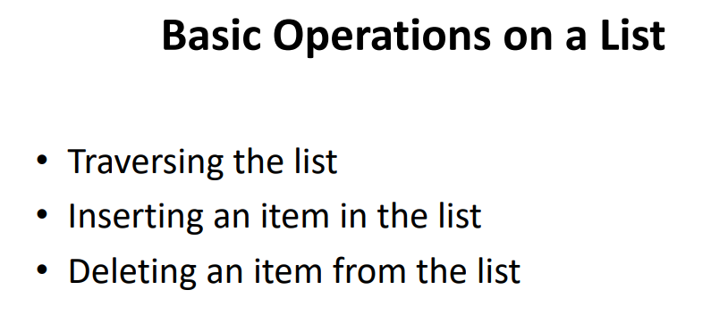

Slide 2
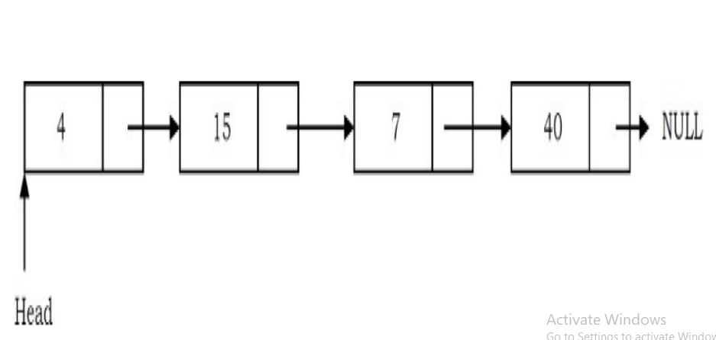
EXAMPLE OF SINGLE LINKED LIST

Slide 3
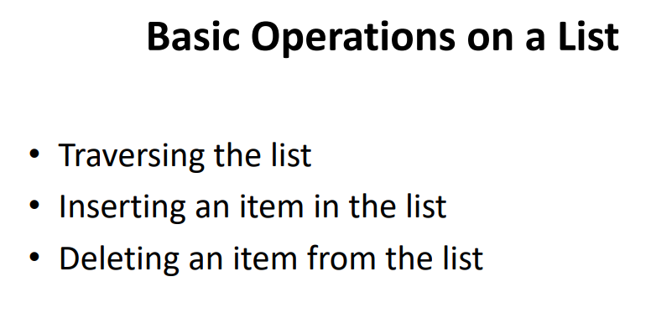

Slide 4
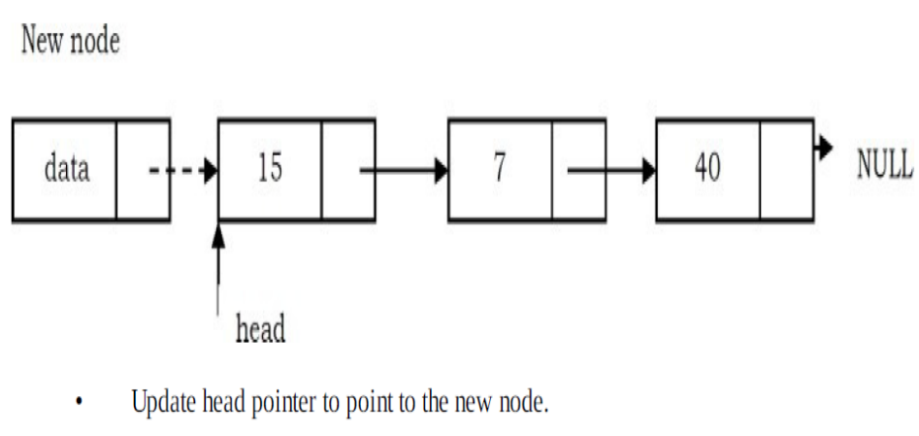
Inserting a Node in Singly Linked List at the Beginning

Slide 5
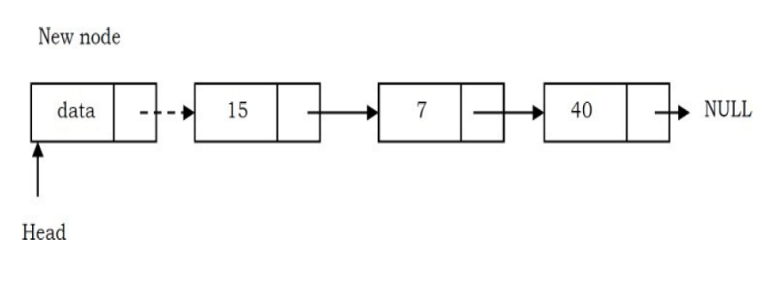

Slide 6
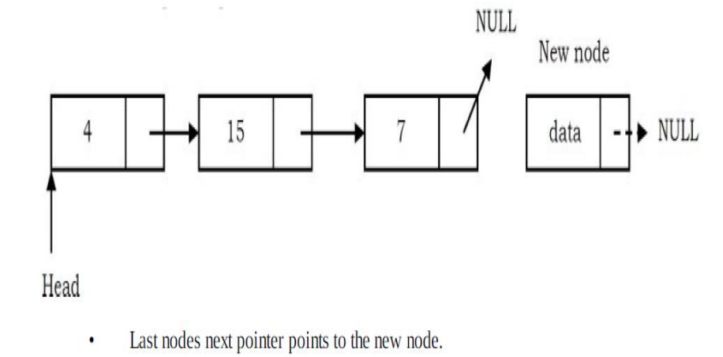
Inserting a Node in Singly Linked List at the Ending

Slide 7
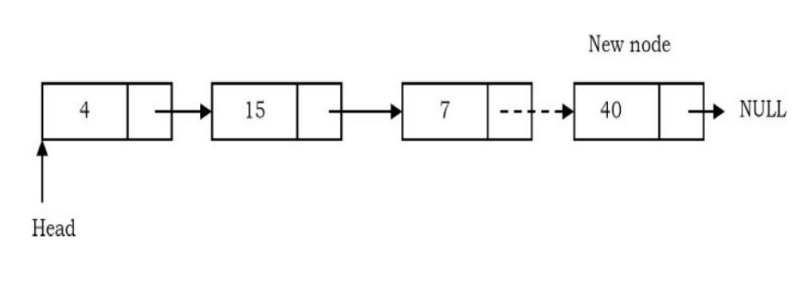

Slide 8
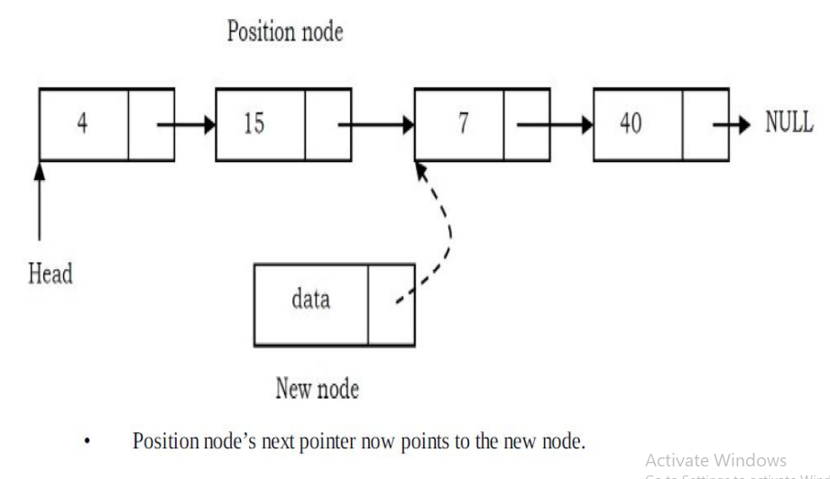
Inserting a Node in Singly Linked List at the Middle

Slide 9
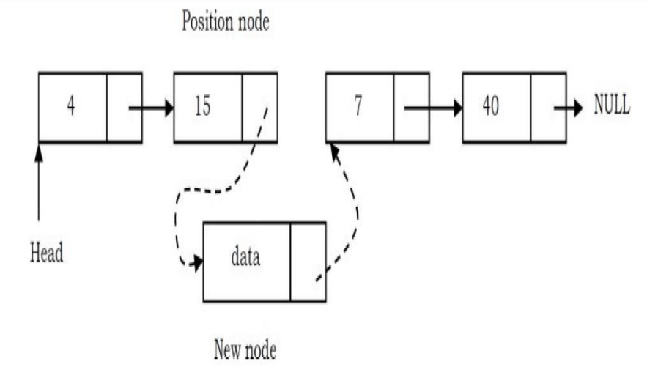

Slide 10

Deleting the First Node in Singly Linked List

Slide 11
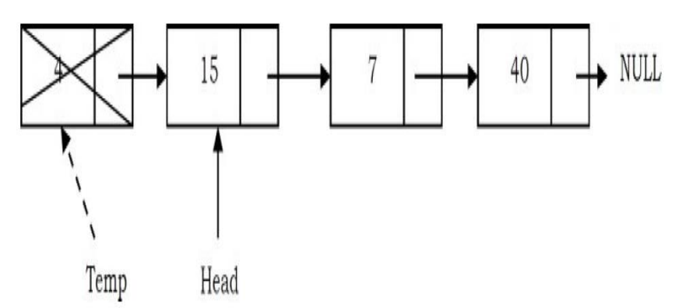

Slide 12
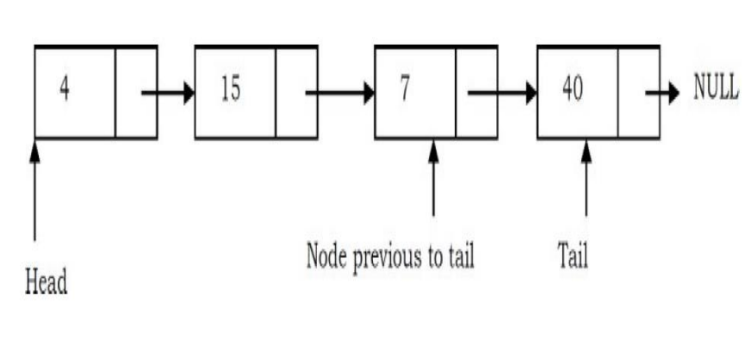
Deleting the Last Node in Singly Linked List

Slide 13
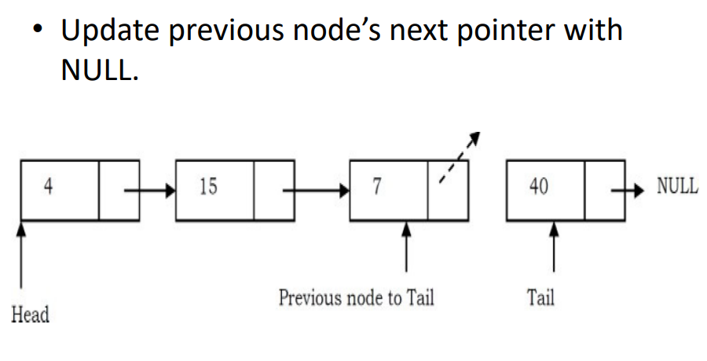

Slide 14
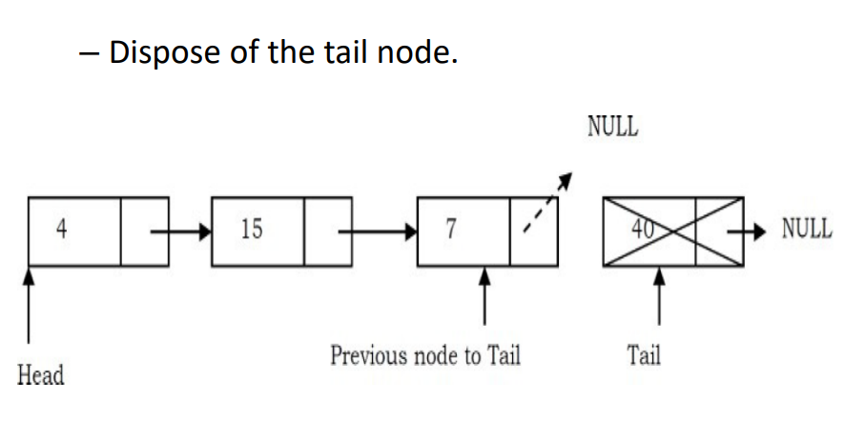

Slide 15
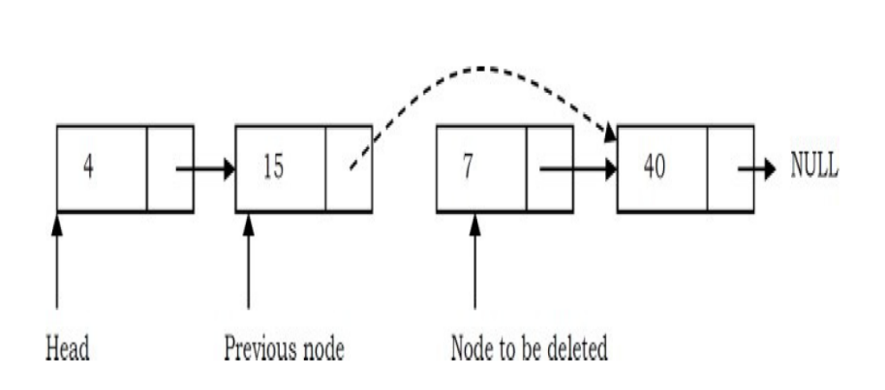
Deleting an Intermediate Node in Singly Linked List

Slide 16
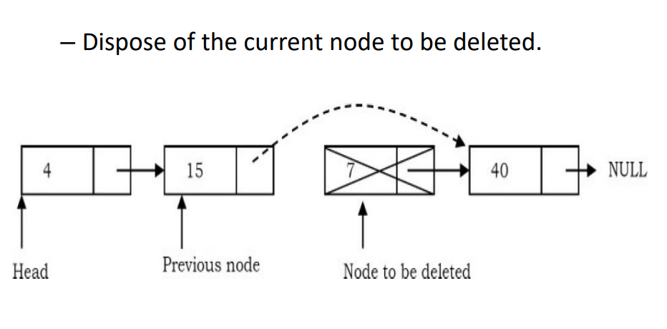

Slide 17
DOUBLY LINKED LIST

Slide 18
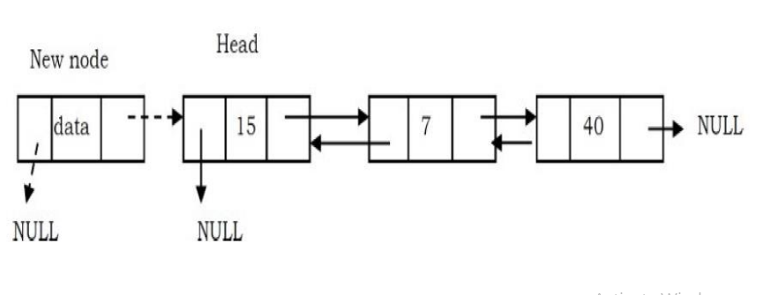
Inserting a Node in Doubly Linked List at the Beginning

Slide 19
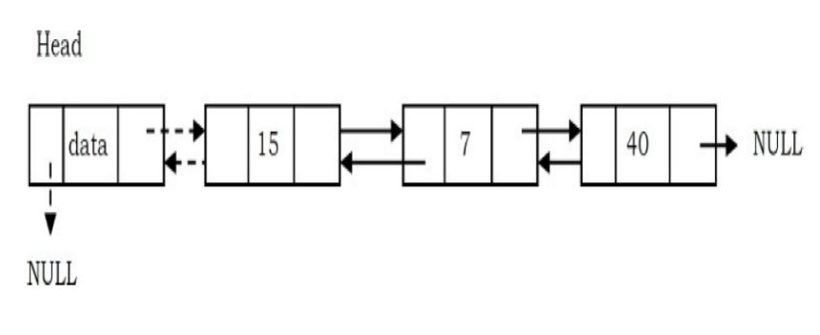

Slide 20

Inserting a Node in Doubly Linked List at the Ending

Slide 21
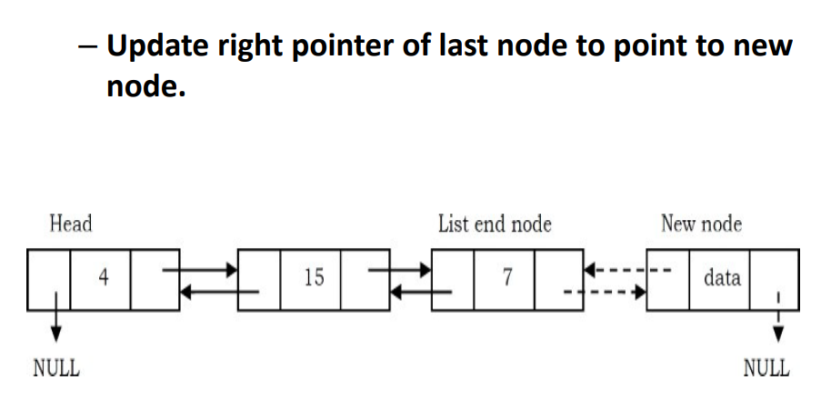

Slide 22
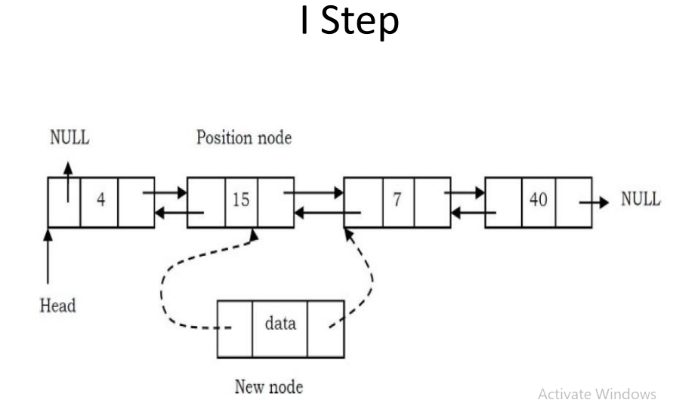
Inserting a Node in Doubly Linked List at the Middle

Slide 23
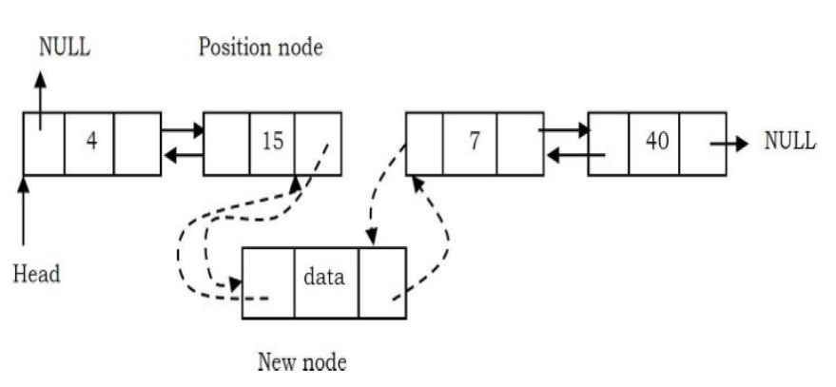
STEP II

Slide 24
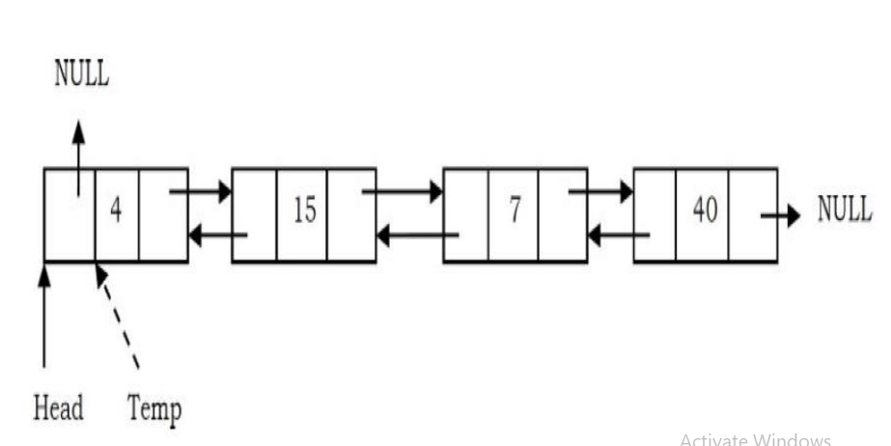
Deleting the First Node in Doubly Linked List

Slide 25
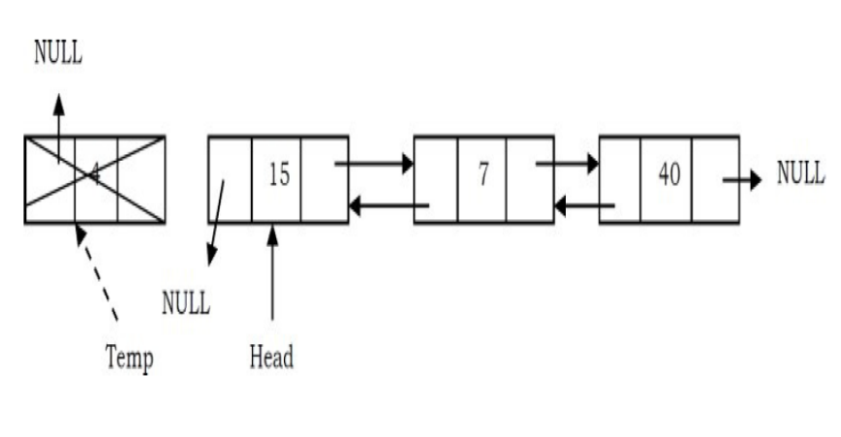

Slide 26
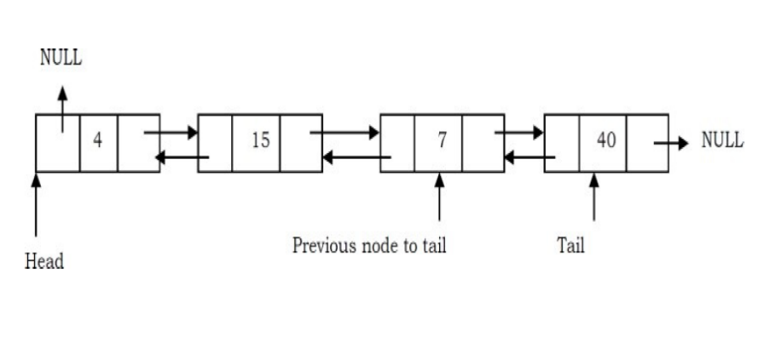
Deleting the Last Node in Doubly Linked List

Slide 27
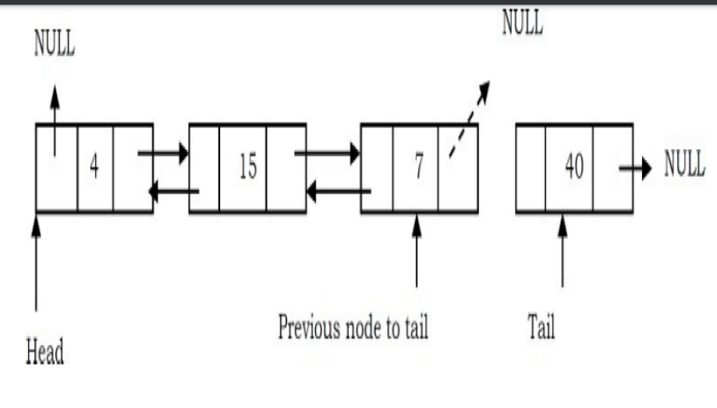

Slide 28
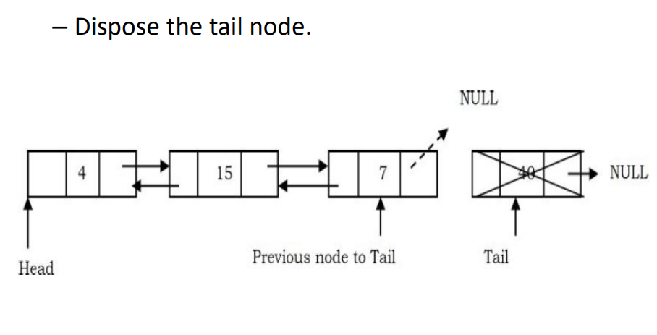

Slide 29
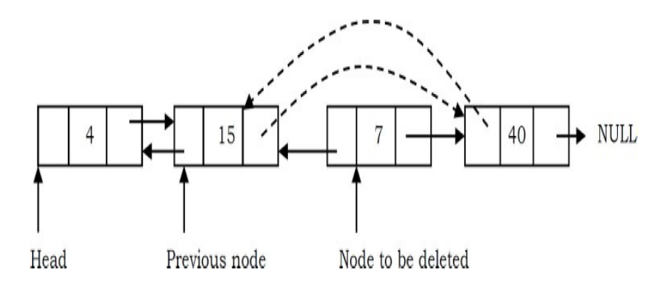
Deleting an Intermediate Node in Doubly Linked List

Slide 30
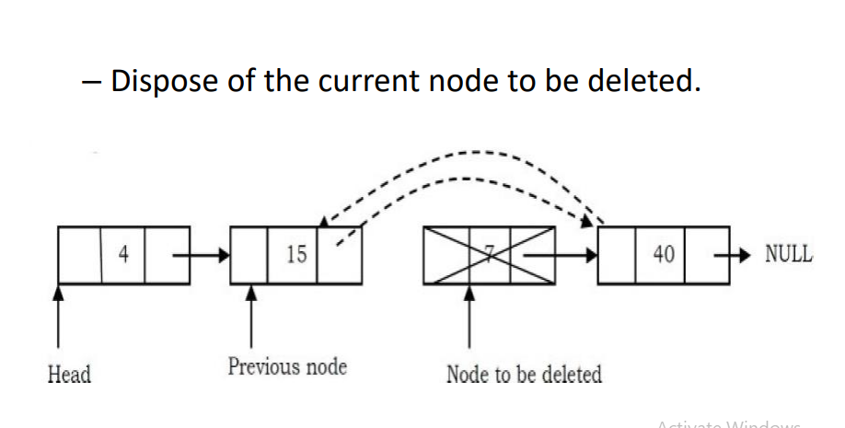

Slide 31
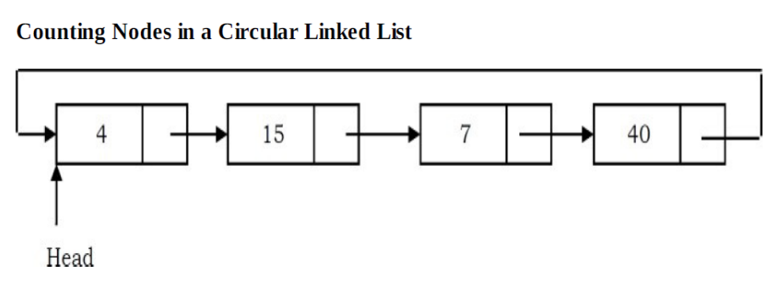
CIRCULAR LINKED LIST

Slide 32
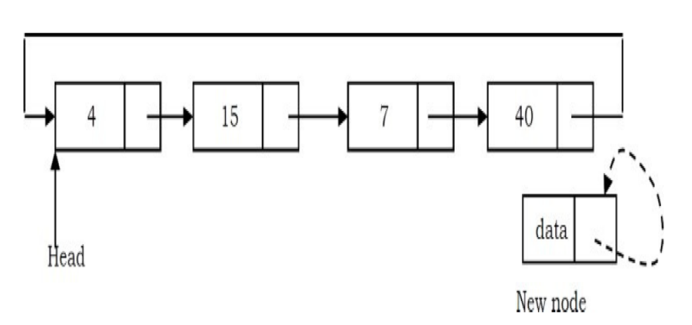
Inserting a Node at the End of a Circular Linked List

Slide 33
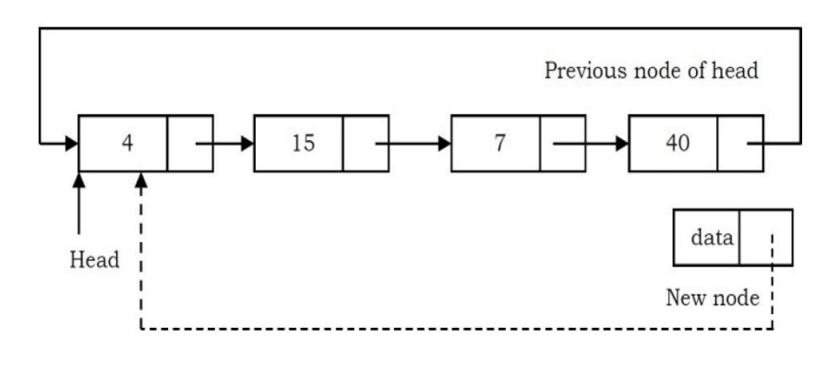

Slide 34
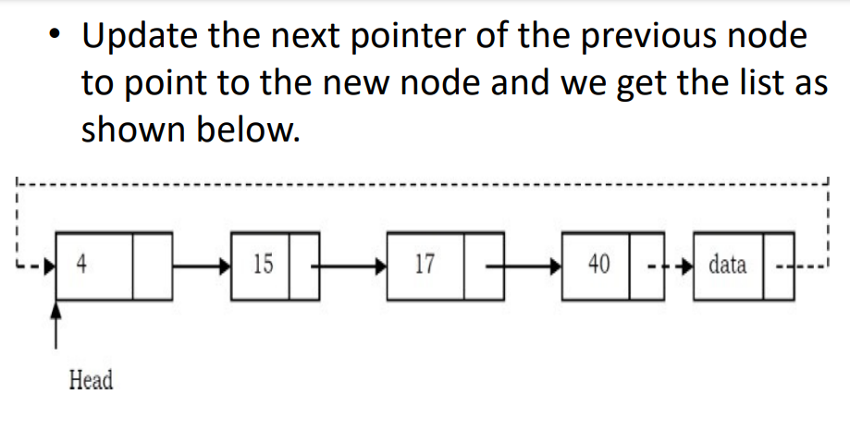

Slide 35
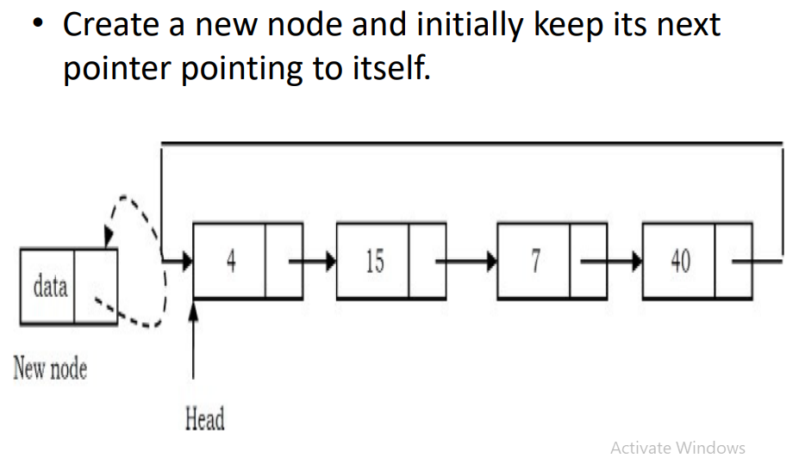
Inserting a Node at the Front of a Circular Linked List

Slide 36
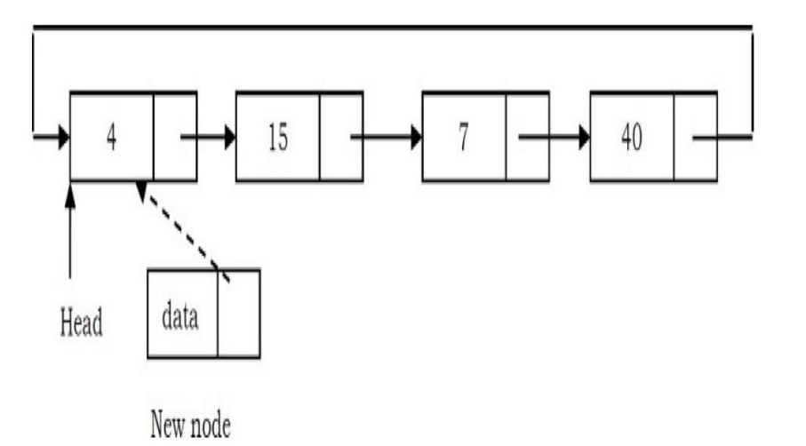

Slide 37
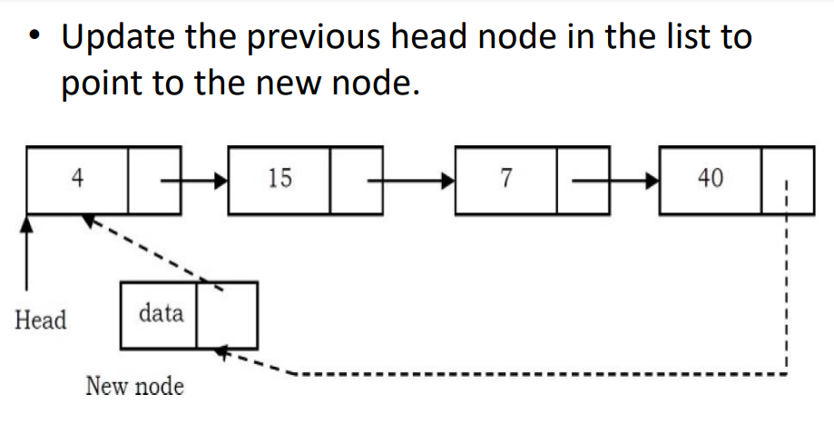

Slide 38
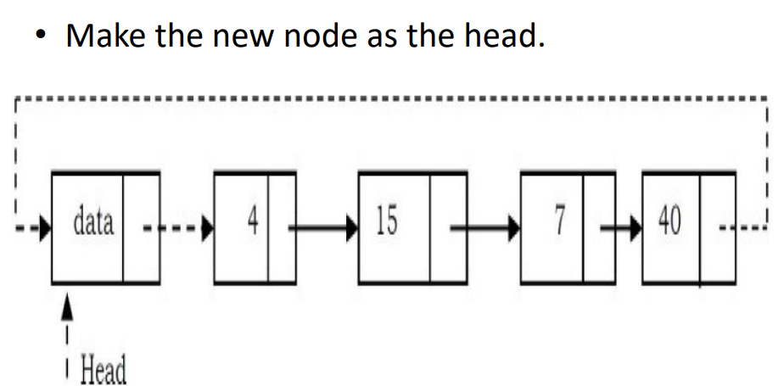

Slide 39
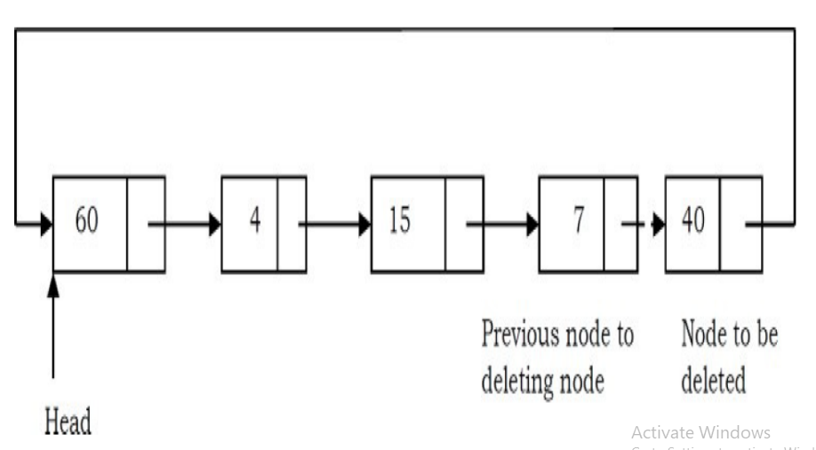
Deleting the Last Node in a Circular Linked List

Slide 40
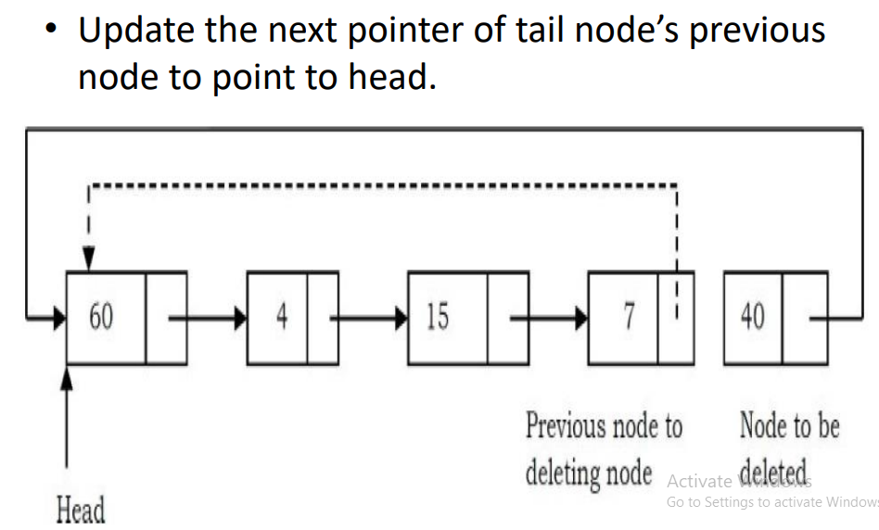

Slide 41
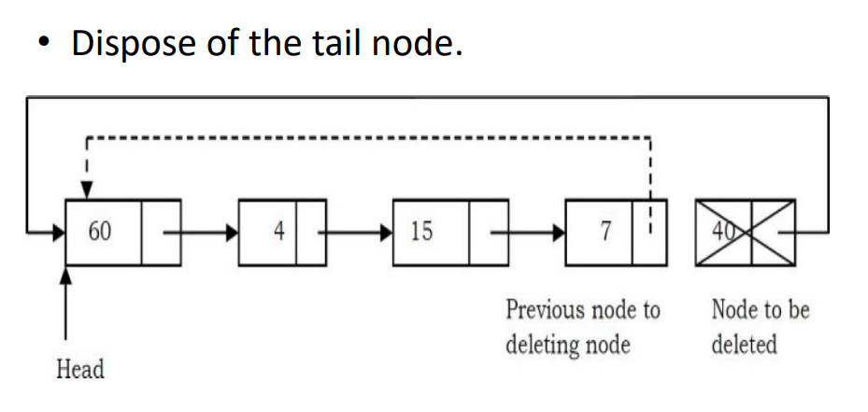

Slide 42
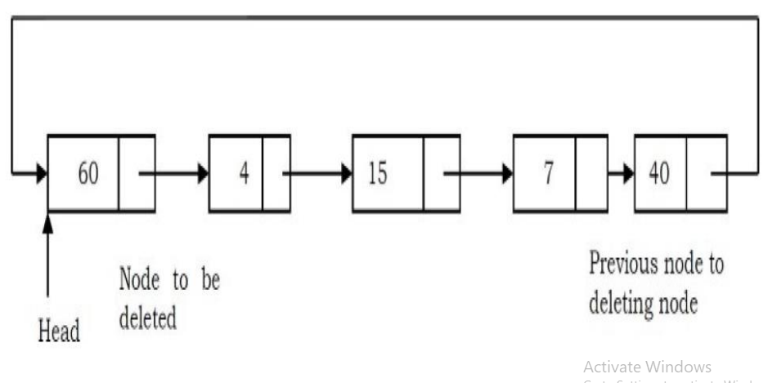
Deleting the First Node in a Circular List

Slide 43
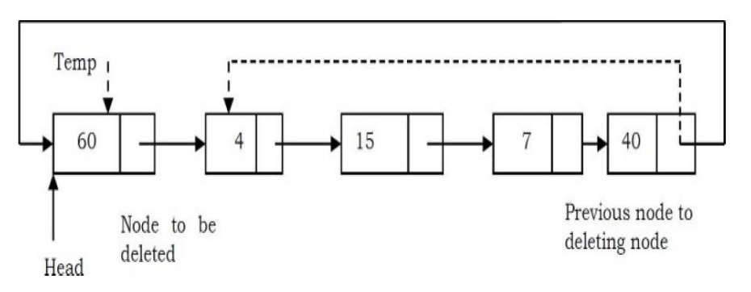

Slide 44
